Slide 1

Multi Layer Perceptron
Amine Kerkeni, Head of Engineering, InstaDeep
ak@instadeep.com

Slide 2
The Perceptron

Slide 3
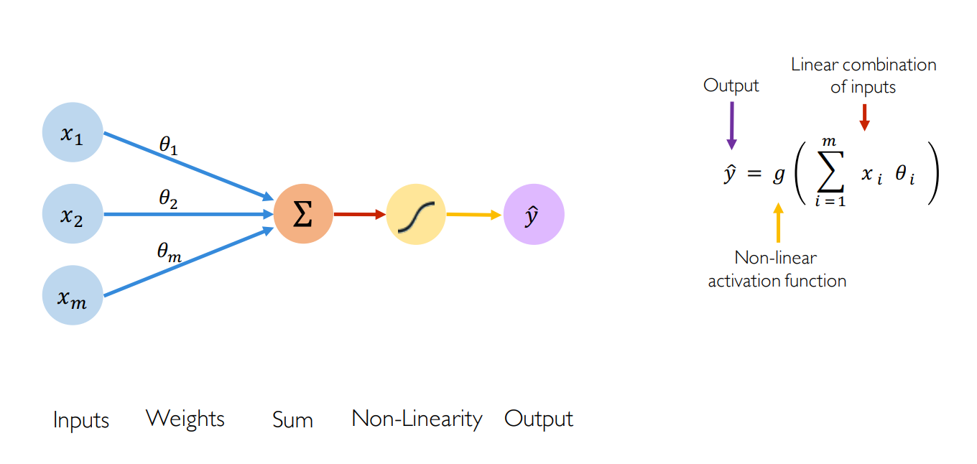
The Forward Propagation

Slide 4
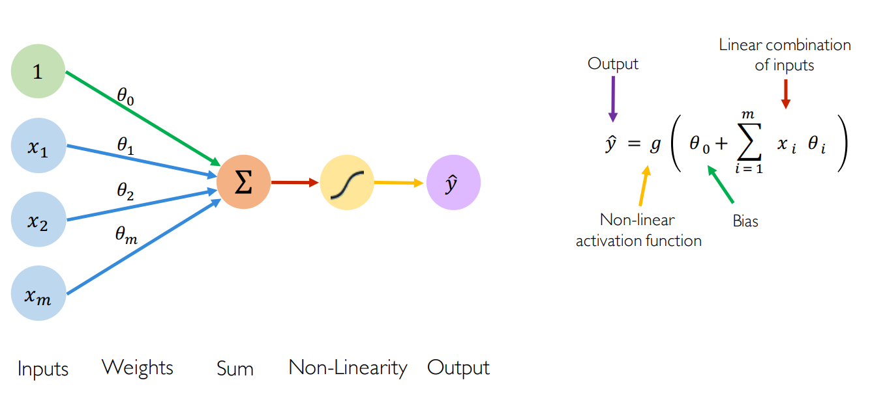
The Forward Propagation

Slide 5
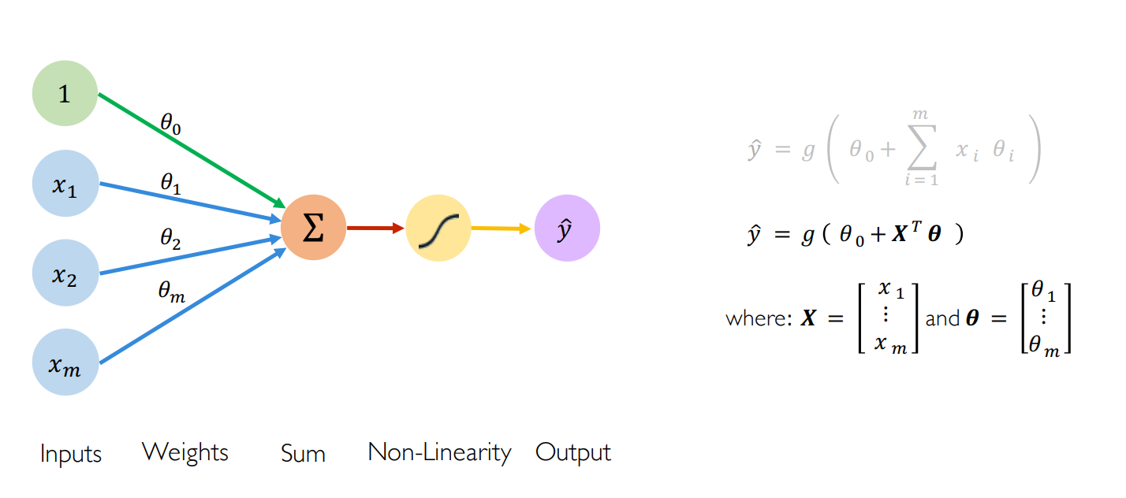
The Forward Propagation

Slide 6
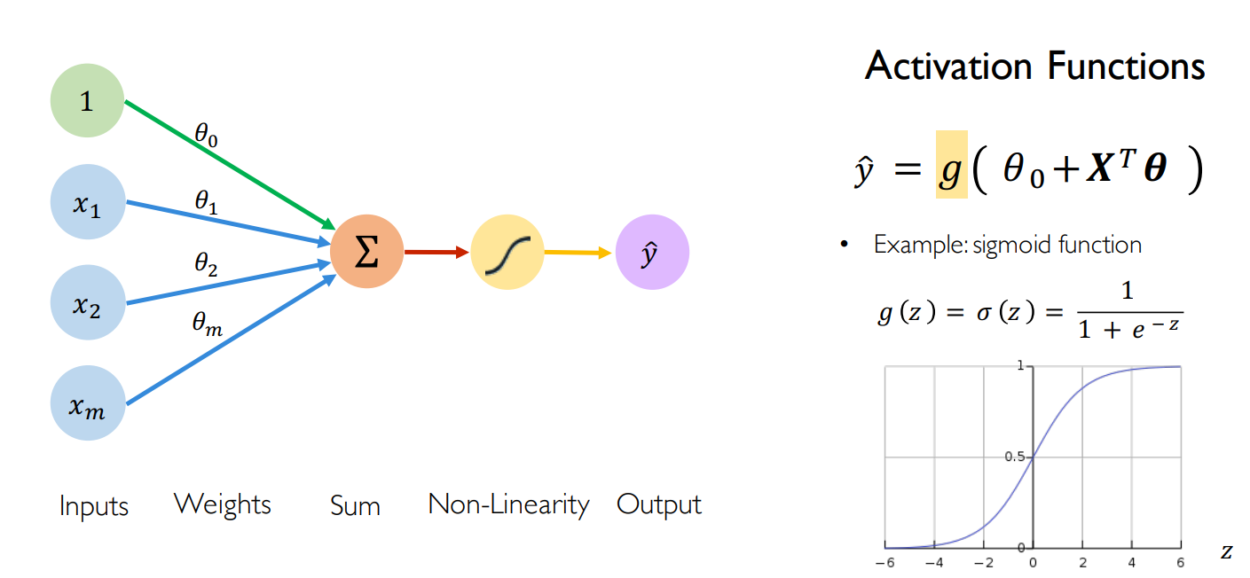
The Forward Propagation

Slide 7
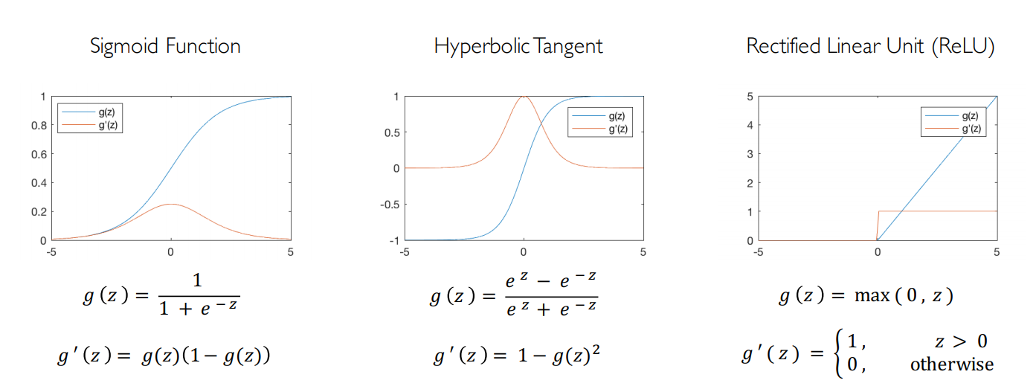
Activations

Slide 8
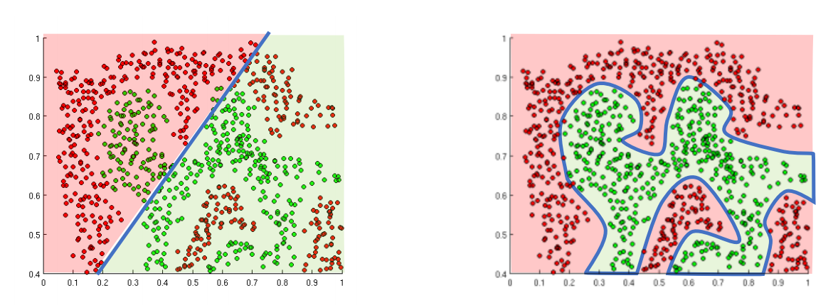
Activations
Activation functions main role is to introduce non-linearity

Slide 9
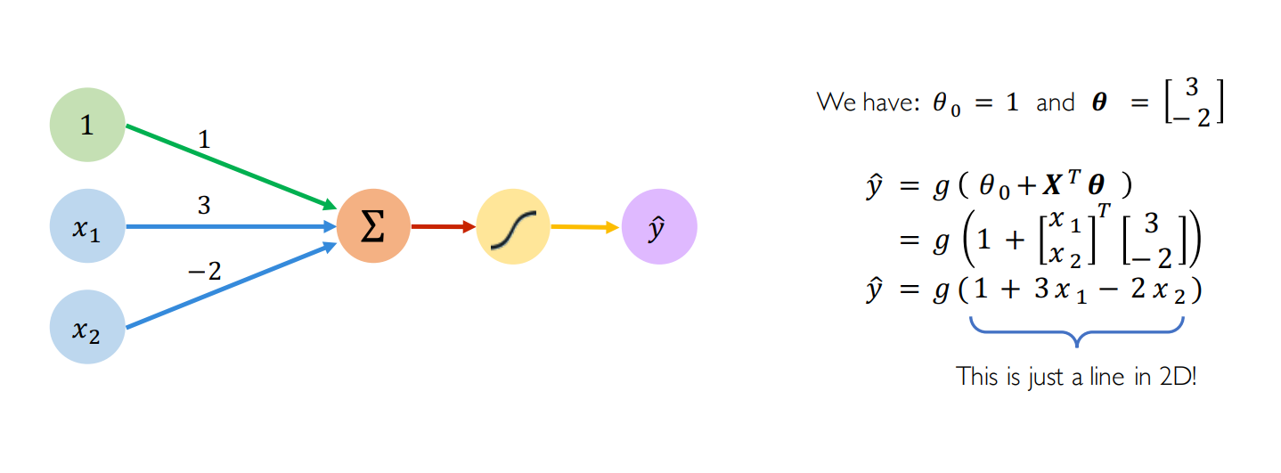
A numerical example

Slide 10
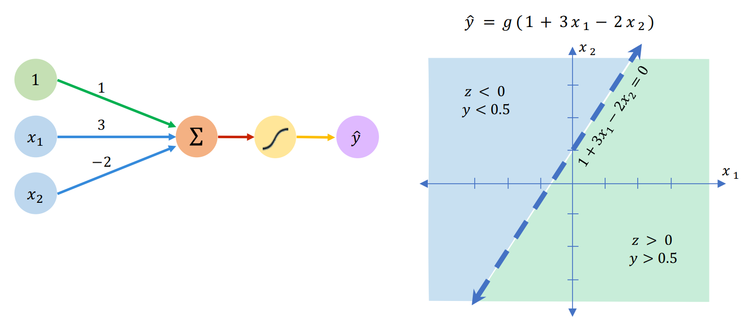
A numerical example

Slide 11
A Neural Network with Perceptron

Slide 12
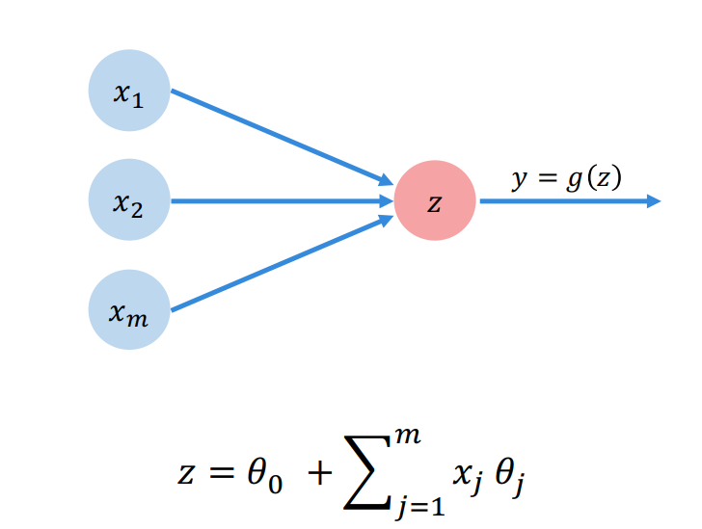
A Simple Perceptron

Slide 13
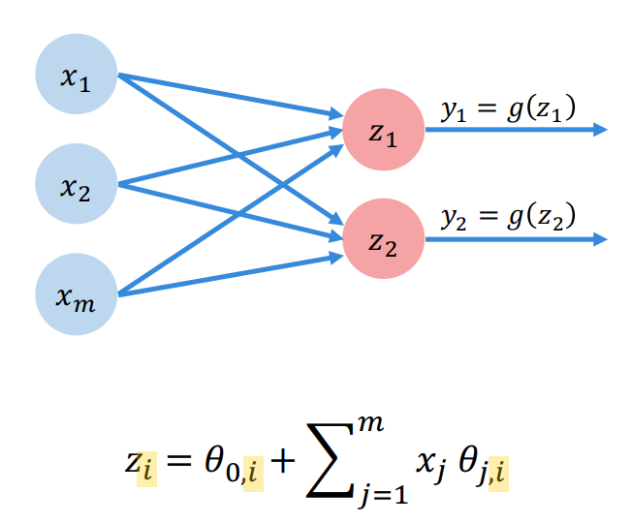
Multi Output Perceptron

Slide 14
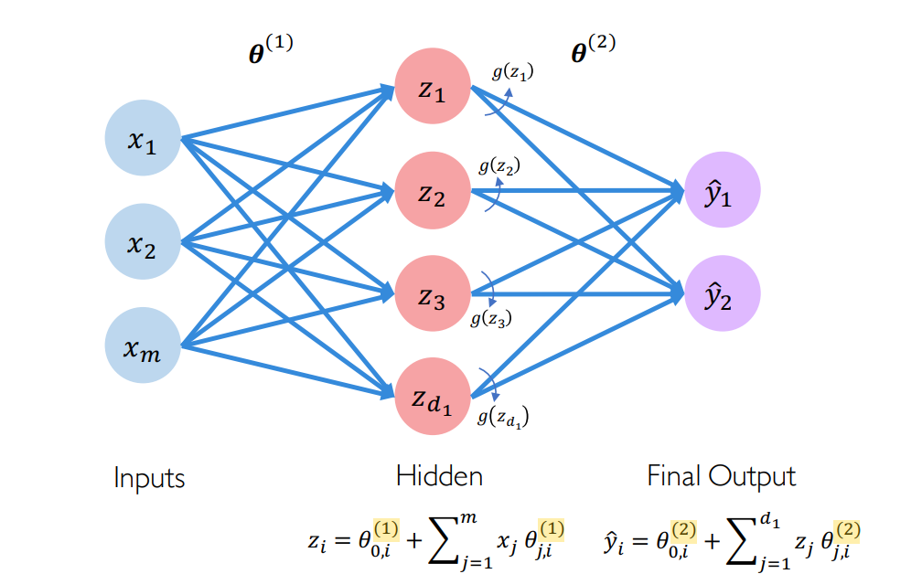
A Neural Network

Slide 15
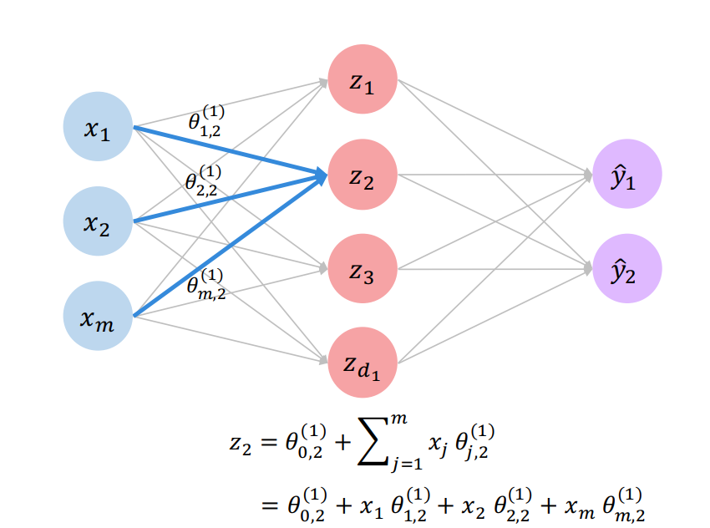
A Neural Network

Slide 16
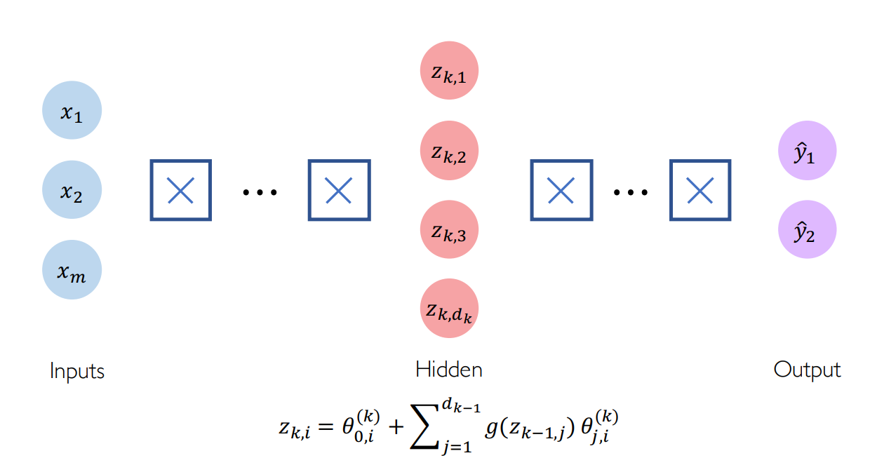
A Deep Neural Network

Slide 17
The Loss

Slide 18
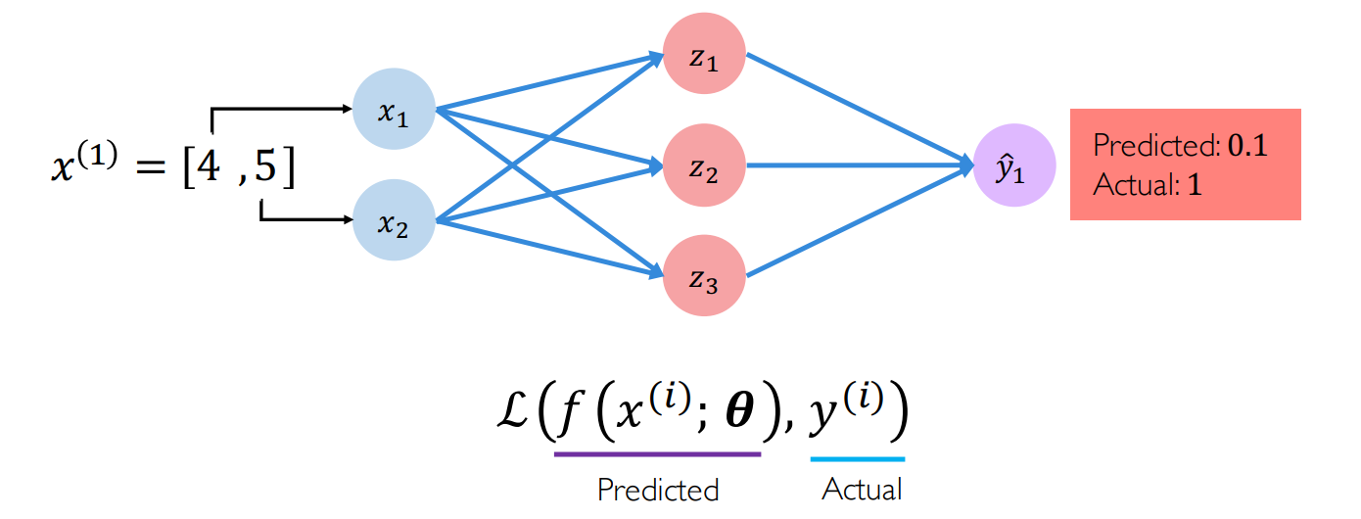
Defining the Loss
The loss is the error between our prediction and the ground truth

Slide 19
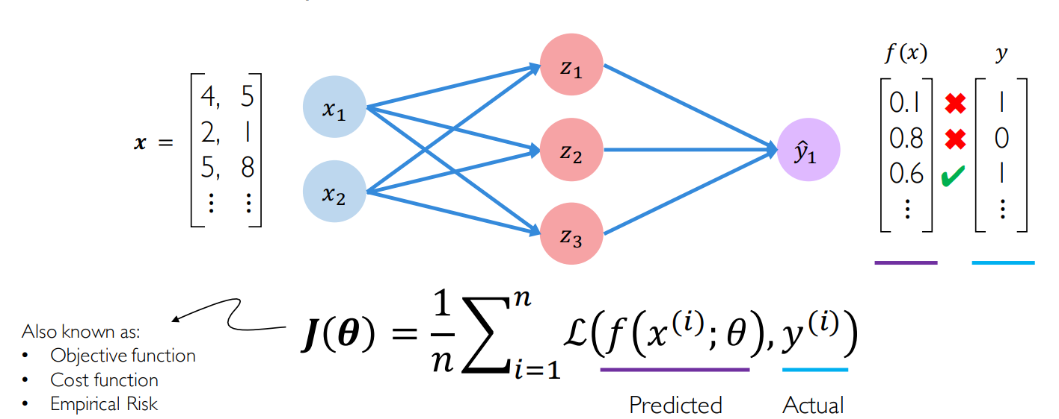
Defining the Loss
The empirical loss is the error measured on the whole dataset

Slide 20
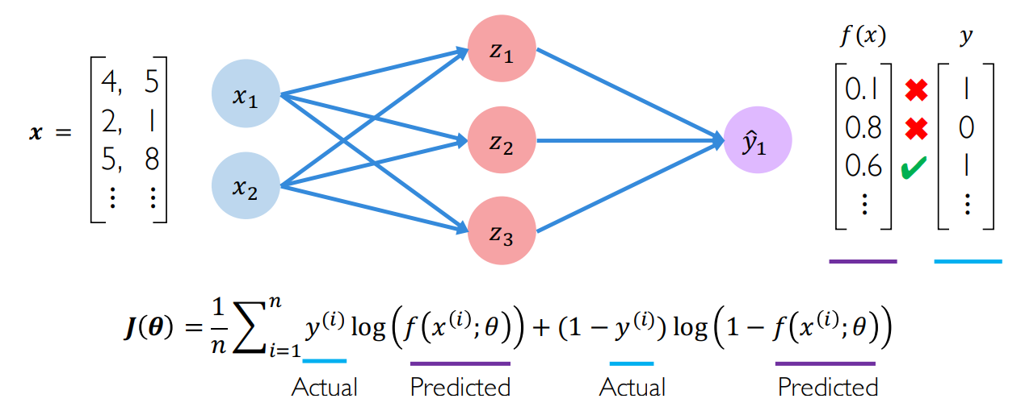
Binary Cross Entropy Loss
Used for models that output predictions between 0 and 1.

Slide 21
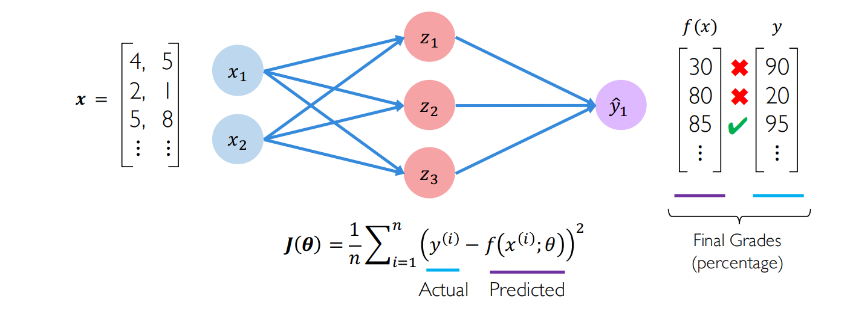
Mean Squared Error Loss
Used for regression models that output continuous real numbers.

Slide 22
Training

Slide 23
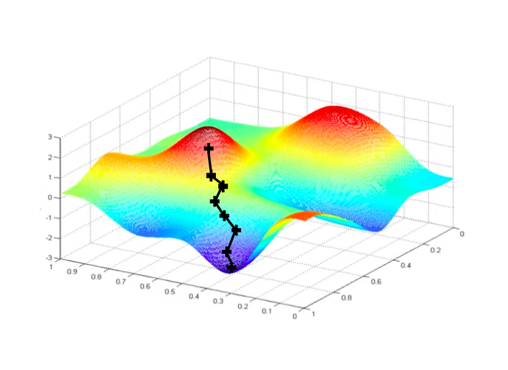
Gradient Descent

Slide 24
Gradient Descent
Deep learning datasets are usually huge: 106∼108 training examples. In consequence, computing the gradient on the full training dataset can be extremely costly
To tackle this, a solution is the compute the gradient of a minibatch of samples and perform an update step with it
This gradient is an unbiased estimation of the full gradient if the minibatch sampling is performed randomly

Slide 25
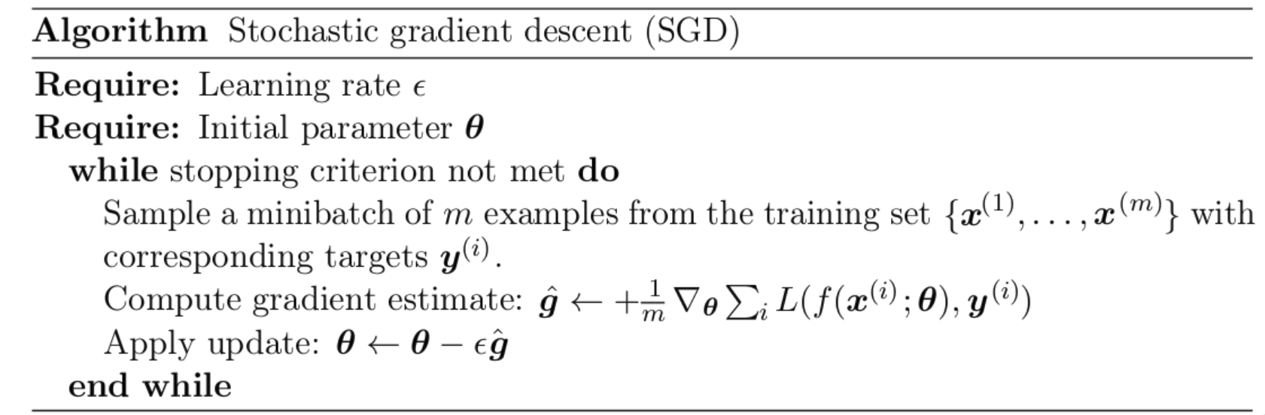
Stochastic Gradient Descent

Slide 26
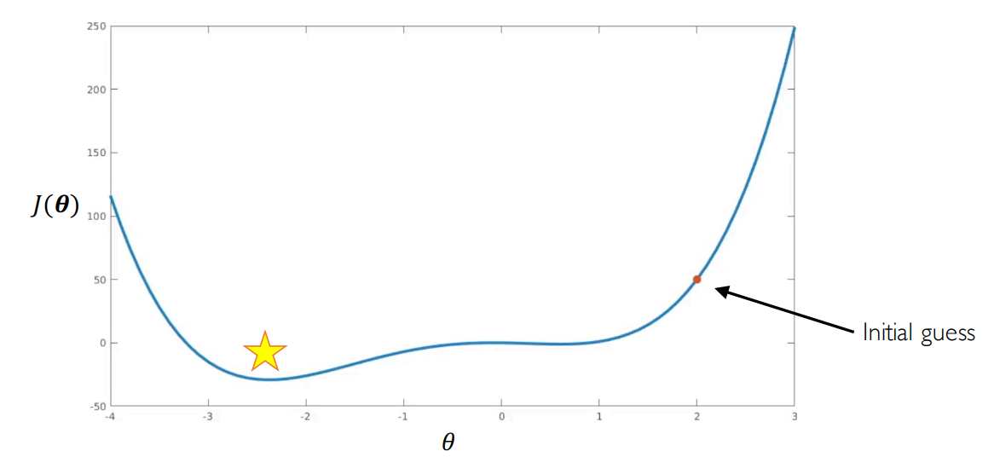
The Learning Rate

Slide 27
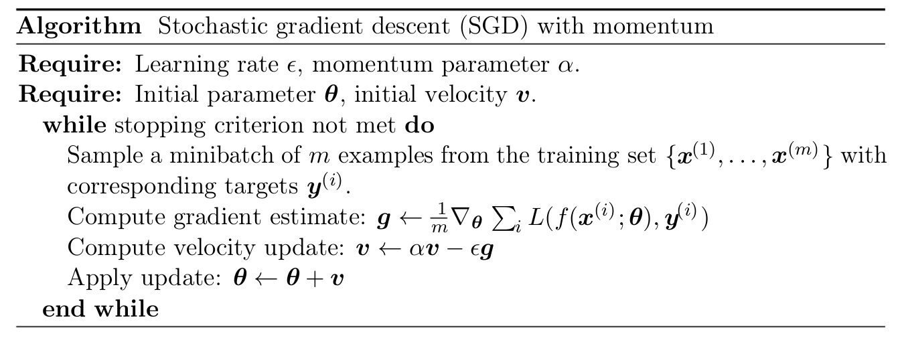
SGD with Momentum

Slide 28
Loss Optimization

Slide 29
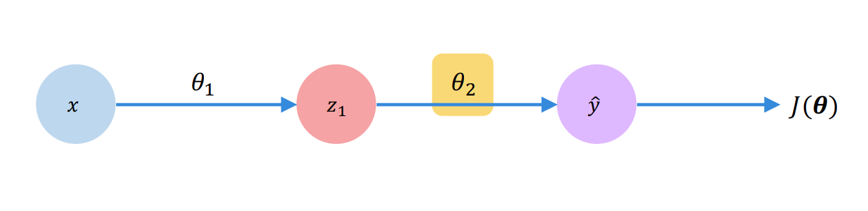
Backpropagation

Slide 30
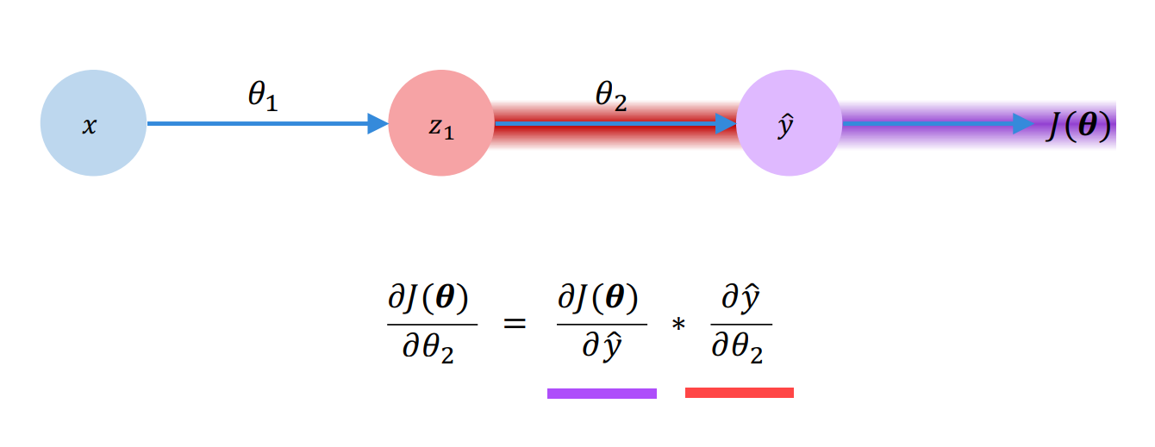
Backpropagation

Slide 31
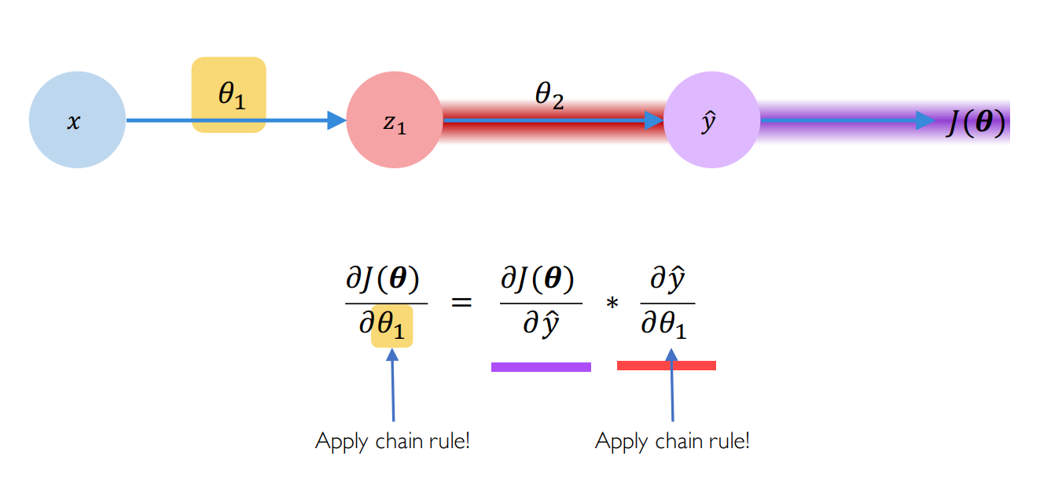
Backpropagation

Slide 32
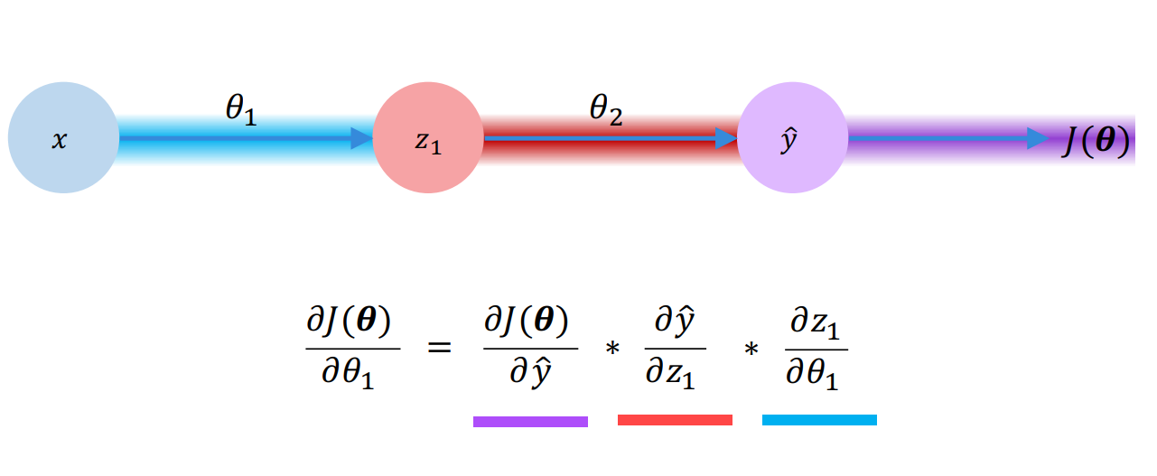
Backpropagation

Slide 33
Training Problems

Slide 34
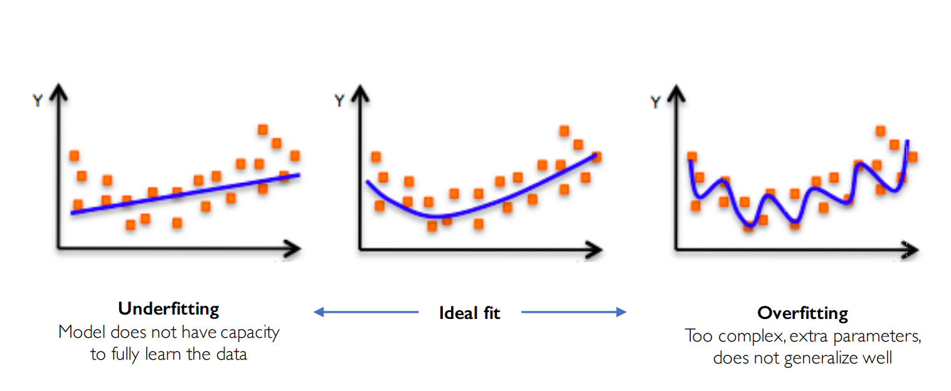
Overfitting

Slide 35
Dropout
Dropout is to randomly set some activations to 0 during training.
It forces the network to avoid relying too much on a single activation.

Slide 36
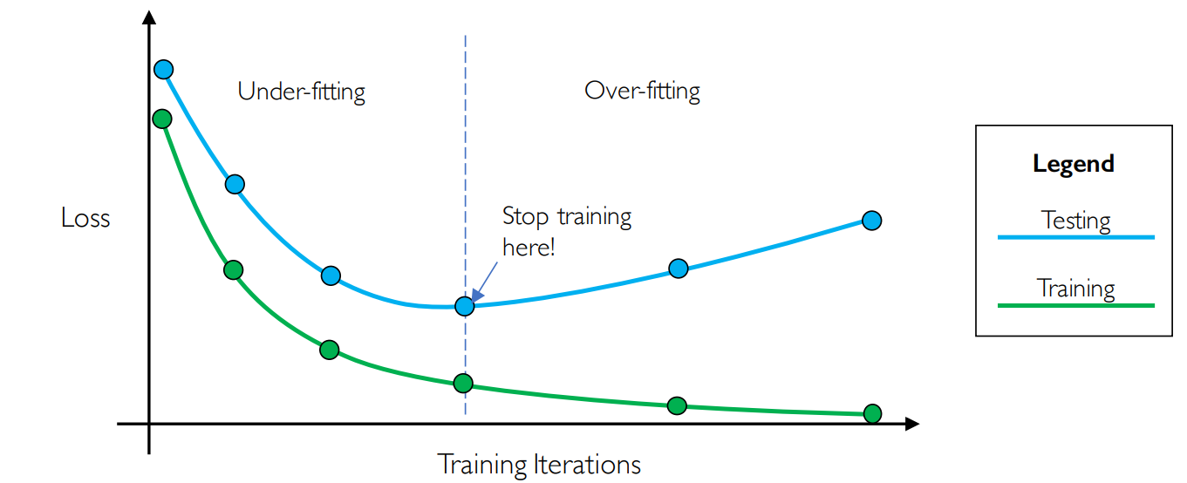
Early Stopping

